Slide 1
PFSD
Review-1

Slide 2
Literature Review
Online Wedding Booking System is a web based project which act as a bridge between potential users and wedding planners. As people spend lots of money on Weddings, Parties and MICE, but they involve their selves in each and every affair in such a way that at the end of the day they feel that they have not seen the wedding of their only Son/Daughter or they have not been able to enjoy the functions. That is why; a Wedding Planner-Co-coordinator is required to make people comfortable on the day of the Wedding /Event. So that I have tried to make a web project so that all the Booking s for the food, venues, invitation cards, bookings can be done on time. This project is developed to make the users comfortable to enjoy each and every function along with their family, friends and relatives. This project organizes the facilities such as Venues & Accommodation, Sets, Themes, Concepts & Decorations, Menu Planning, F & B and Bar Tendering Services, Music & Entertainment.

Slide 3
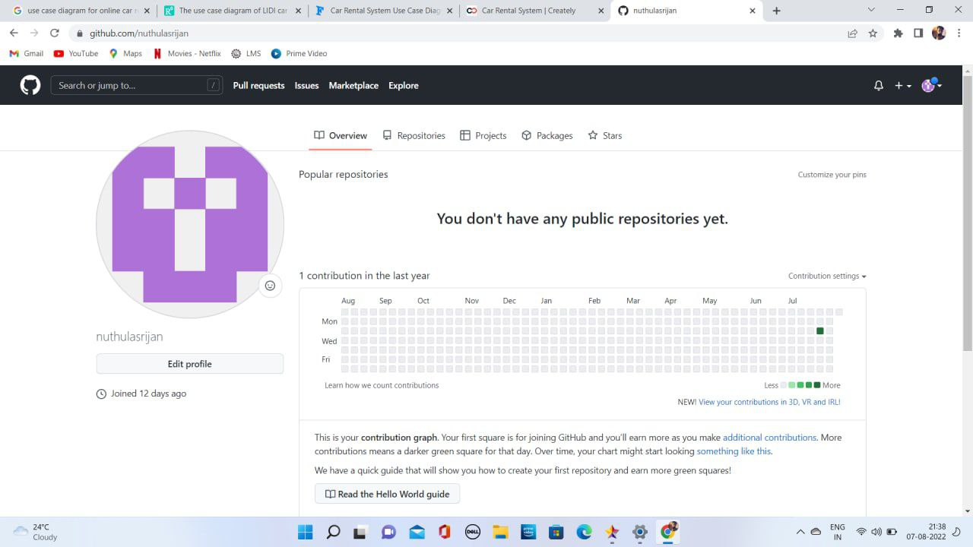
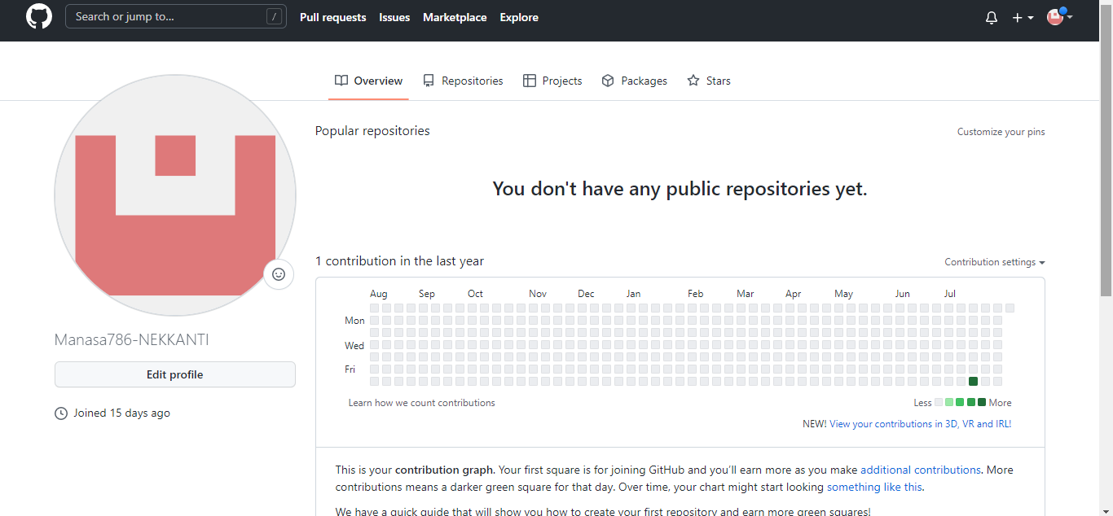
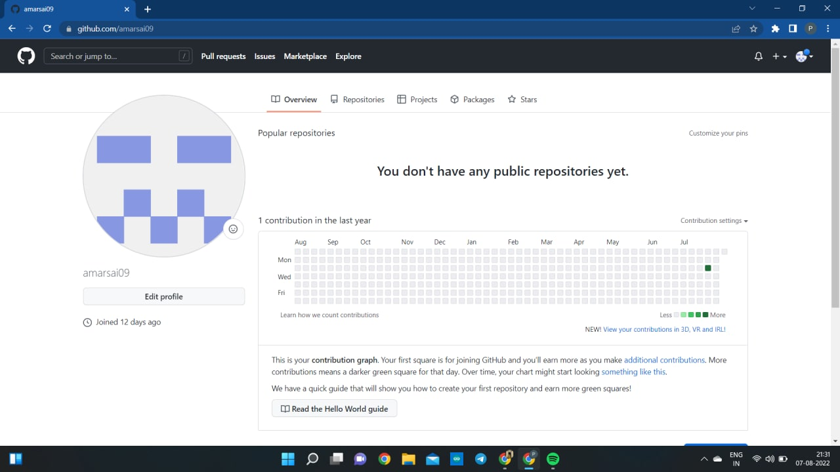
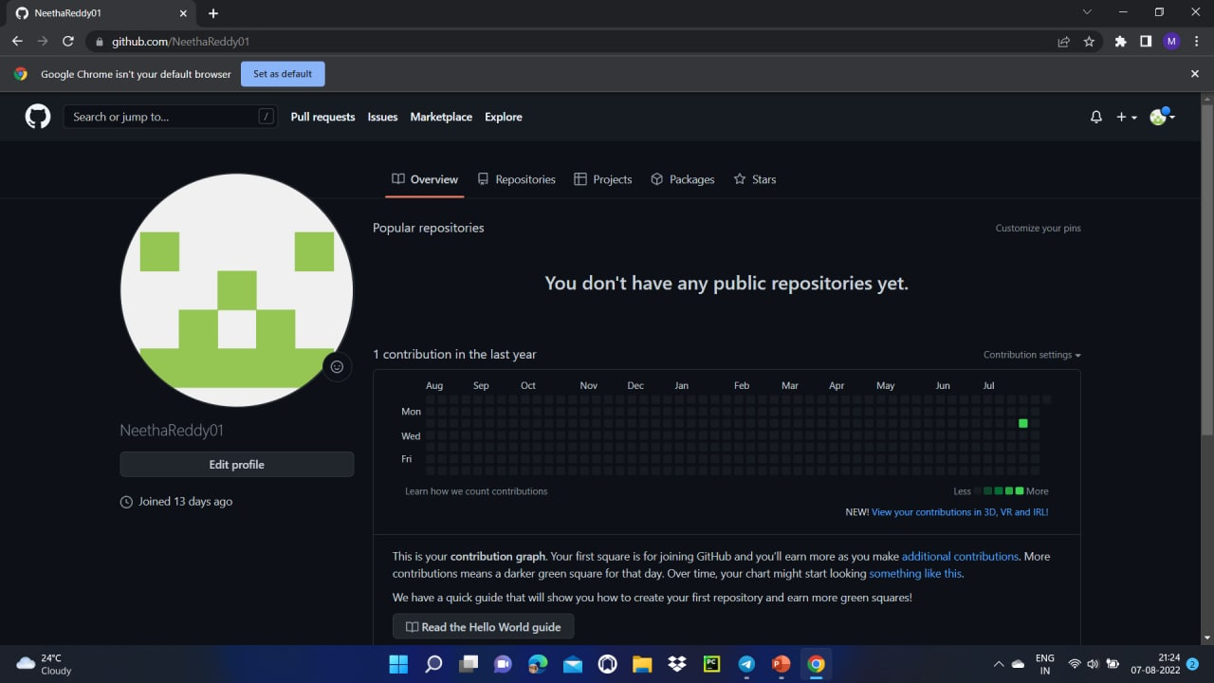
Github Setup:

Slide 4
Work allocation to team members
2110030373-github setup and tools verification.
2110030389- documentation and work allotment.
2110030432-Data set collection and tools setup.
2110030393-documentation and tools verification.

Slide 5
Data set collection and tools setup
HTML- page layout has been designed in HTML.
CSS-It has been used in all designing parts.
Javascript-All the validation task and animations has been developed here.
Python-All the business logic has been implemented in python.
MySQL-This database has been used as database for the project.
Django-This has been used for the framework.

Slide 6
Configurations for this project:
Windows: This project can be configured in windows easily,need to install Python, Django , PIP.
Linux: we can run this project on all versions of operating systems.
Mac :we can run this project on operating systems also.

